Slide 1

CHAPTER 8
PROPERTIES OF RELATIONS
Copyright © Cengage Learning. All rights reserved.

Slide 2

8.2
Reflexivity, Symmetry, and Transitivity
Copyright © Cengage Learning. All rights reserved.

Slide 3




Reflexivity, Symmetry, and Transitivity
Let A = {2, 3, 4, 6, 7, 9} and define a relation R on A as follows: For every x, y ∈ A,
Then 2 R 2 because 2 − 2 = 0, and
Similarly, 3 R 3, 4 R 4, 6 R 6, 7 R 7, and 9 R 9.
Also 6 R 3 because 6 − 3 = 3, and
And 3 R 6 because 3 − 6 = −(6 − 3) = −3, and
Similarly, 3 R 9, 9 R 3, 6 R 9, 9 R 6, 4 R 7, and 7 R 4.

Slide 4
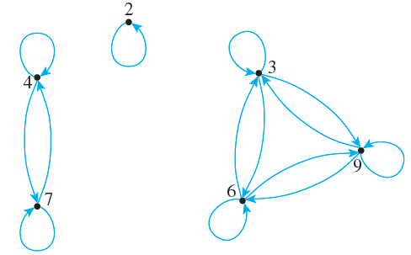
Reflexivity, Symmetry, and Transitivity
Thus the directed graph for R has the appearance shown below.

Slide 5
Reflexivity, Symmetry, and Transitivity
This graph has three important properties:
1. Each point of the graph has an arrow looping around from it and going back to it.
2. In each case where there is an arrow going from one point to a second, there is an arrow going from the second point back to the first.
3. In each case where there is an arrow going from one point to a second and from the second point to a third, there is an arrow going from the first point to the third. That is, there are no “incomplete directed triangles” in the graph.

Slide 6
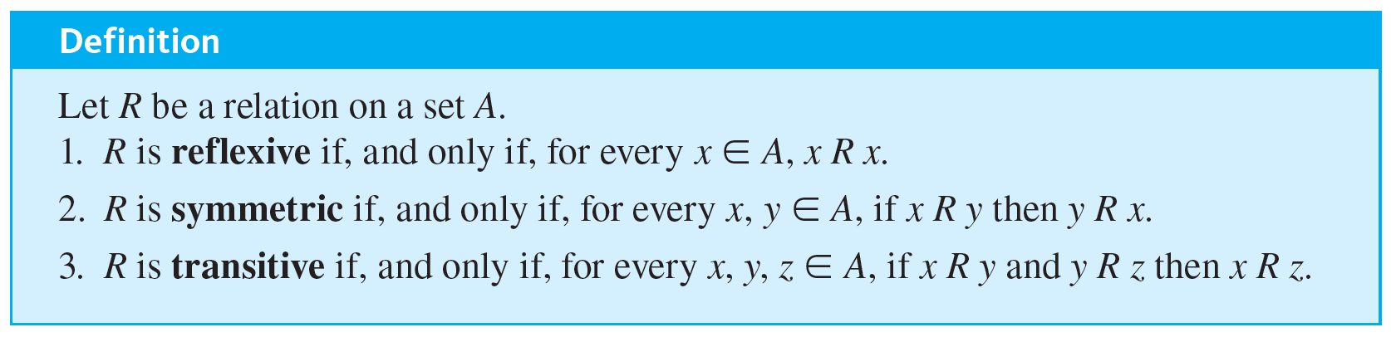
Reflexivity, Symmetry, and Transitivity
Properties (1), (2), and (3) correspond to properties of general relations called reflexivity, symmetry, and transitivity.

Slide 7
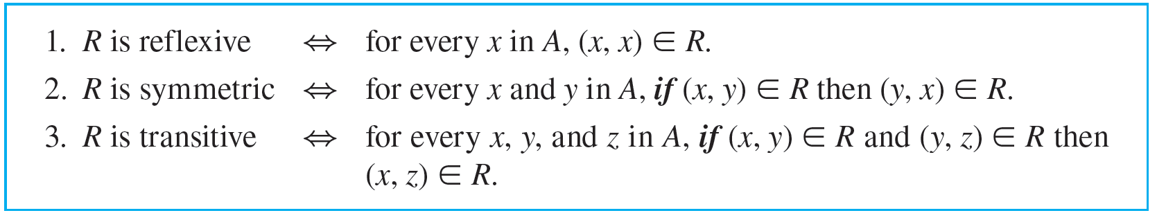
Reflexivity, Symmetry, and Transitivity
The equivalence of the expressions x R y and (x, y) ∈ R for every x and y in A, the reflexive, symmetric, and transitive properties can also be written as follows:

Slide 8
Reflexivity, Symmetry, and Transitivity
In informal terms, properties (1)–(3) say the following:
1. Reflexive: Each element is related to itself.
2. Symmetric: If any one element is related to any other element, then the second element is related to the first.
3. Transitive: If any one element is related to a second and that second element is related to a third, then the first element is related to the third.
Note that the definitions of reflexivity, symmetry, and transitivity are universal statements.

Slide 9
Reflexivity, Symmetry, and Transitivity
This means that to prove a relation has one of the properties, you use either the method of exhaustion or the method of generalizing from the generic particular.
Recall that the negation of a universal statement is existential. Hence if R is a relation on a set A, then
1. R is not reflexive ⇔ there is an element x in A such that
[that is, such that (x, x) ∉ R].

Slide 10

Reflexivity, Symmetry, and Transitivity
2. R is not symmetric ⇔ there are elements x and y in A such that x R y but
[that is, such that (x, y) ∈ R but (y, x) ∉ R].
3. R is not transitive ⇔ there are elements x, y, and z in A such that x R y and y R z but
[that is, such that (x, y) ∈ R and (y, z) ∈ R but (x, z) ∉ R].
It follows that you can show that a relation does not have one of the properties by finding a counterexample.

Slide 11
Example 8.2.1 – Properties of Relations on Finite Sets
Let A = {0, 1, 2, 3} and define relations R, S, and T on A as follows:
R = {(0, 0), (0, 1), (0, 3), (1, 0), (1, 1), (2, 2), (3, 0), (3, 3)},
S = {(0, 0), (0, 2), (0, 3), (2, 3)},
T = {(0, 1), (2, 3)}.
a. Is R reflexive? symmetric? transitive?
b. Is S reflexive? symmetric? transitive?
c. Is T reflexive? symmetric? transitive?

Slide 12
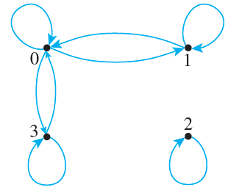
Example 8.2.1 – Solution
a. The directed graph of R has the appearance shown below.
R is reflexive: There is a loop at each point of the directed graph. This means that each element of A is related to itself, so R is reflexive.

Slide 13
Example 8.2.1 – Solution
continued
R is symmetric: In each case where there is an arrow going from one point of the graph to a second, there is an arrow going from the second point back to the first.
This means that whenever one element of A is related by R to a second, then the second is related to the first. Hence R is symmetric.
R is not transitive: There is an arrow going from 1 to 0 and an arrow going from 0 to 3, but there is no arrow going from 1 to 3.

Slide 14
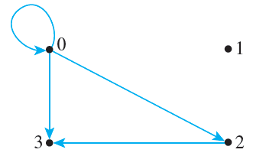
Example 8.2.1 – Solution
continued
This means that there are elements of A—0, 1, and 3—such that 1 R 0 and 0 R 3 but
Hence R is not transitive.
b. The directed graph of S has the appearance shown below.

Slide 15
Example 8.2.1 – Solution
continued
S is not reflexive: There is no loop at 1, for example. Thus (1, 1) ∉ S, and so S is not reflexive.
S is not symmetric: There is an arrow from 0 to 2 but not from 2 to 0. Hence (0, 2) ∈ S but (2, 0) ∉ S, and so S is not symmetric.
S is transitive: There are three cases for which there is an arrow going from one point of the graph to a second and from the second point to a third.

Slide 16
Example 8.2.1 – Solution
continued
In particular, there are arrows going from 0 to 2 and from 2 to 3; there are arrows going from 0 to 0 and from 0 to 2; and there are arrows going from 0 to 0 and from 0 to 3.
In each case there is an arrow going from the first point to the third. (Note again that the “first,” “second,” and “third” points need not be distinct.)
This means that whenever (x, y) ∈ S and (y, z) ∈ S, then (x, z) ∈ S, for every x, y, z ∈ {0, 1, 2, 3}, and so S is transitive.

Slide 17


Example 8.2.1 – Solution
continued
c. The directed graph of T has the appearance shown below.
T is not reflexive: There is no loop at 0, for example. Thus (0, 0) ∉ T, so T is not reflexive.
T is not symmetric: There is an arrow from 0 to 1 but not from 1 to 0. Thus (0, 1) ∈ T but (1, 0) ∉ T, and so T is not symmetric.

Slide 18
Example 8.2.1 – Solution
continued
T is transitive: The transitivity condition is vacuously true for T. To see this, observe that the transitivity condition says that
For every x, y, z ∈ A, if (x, y) ∈ T and (y, z) ∈ T then (x, z) ∈ T.
The only way for this to be false would be for there to exist elements of A that make the hypothesis true and the conclusion false.

Slide 19
Example 8.2.1 – Solution
continued
That is, there would have to be elements x, y, and z in A such that
(x, y) ∈ T and (y, z) ∈ T and (x, z) ∉ T.
In other words, there would have to be two ordered pairs in T that have the potential to “link up” by having the second element of one pair be the first element of the other pair.
But the only elements in T are (0, 1) and (2, 3), and these do not have the potential to link up.

Slide 20
Example 8.2.1 – Solution
continued
Hence the hypothesis is never true. It follows that it is impossible for T not to be transitive, and thus T is transitive.

Slide 21
Properties of Relations on Infinite Sets

Slide 22
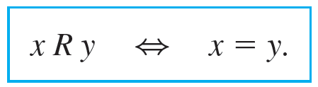
Example 8.2.2 – Properties of Equality
Define a relation R on R as follows: For all real numbers x and y,
a. Is R reflexive? b. Is R symmetric? c. Is R transitive?

Slide 23
Example 8.2.2 – Solution
a. R is reflexive: R is reflexive if, and only if, the following statement is true:
For every x ∈ R, x R x.
Since x R x just means that x = x, this is the same as saying
For every x ∈ R, x = x.
But this statement is certainly true; every real number is equal to itself.

Slide 24
Example 8.2.2 – Solution
continued
b. R is symmetric: R is symmetric if, and only if, the following statement is true:
For every x, y ∈ R, if x R y then y R x.
By definition of R, x R y means that x = y and y R x means that y = x. Hence R is symmetric if, and only if,
For every x, y ∈ R, if x = y then y = x.
But this statement is certainly true; if one number is equal to a second, then the second is equal to the first.

Slide 25
Example 8.2.2 – Solution
continued
c. R is transitive: R is transitive if, and only if, the following statement is true:
For every x, y, z ∈ R, if x R y and y R z then x R z.
By definition of R, x R y means that x = y, y R z means that y = z, and x R z means that x = z.
Hence R is transitive if, and only if, the following statement is true:
For every x, y, z ∈ R, if x = y and y = z then x = z.

Slide 26
Example 8.2.2 – Solution
continued
But this statement is certainly true: If one real number equals a second and the second equals a third, then the first equals the third.

Slide 27
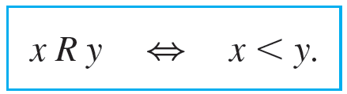
Example 8.2.3 – Properties of “Less Than”
Define a relation R on R as follows: For all real numbers x and y,
a. Is R reflexive? b. Is R symmetric? c. Is R transitive?

Slide 28
Example 8.2.3 – Solution
a. R is not reflexive: R is reflexive if, and only if, ∀x ∈ R, x R x. By definition of R, this means that ∀x ∈ R, x < x. But this is false: ∃x ∈ R such that x ≮ x.
As a counterexample, let x = 0 and note that 0 ≮ 0. Hence R is not reflexive.
b. R is not symmetric: R is symmetric if, and only if, ∀x, y ∈ R, if x R y then y R x. By definition of R, this means that ∀x, y ∈ R, if x < y then y < x.

Slide 29
Example 8.2.3 – Solution
continued
But this is false: ∃x, y ∈ R such that x < y and y ≮ x. As a counterexample, let x = 0 and y = 1 and note that 0 < 1 but 1 ≮ 0. Hence R is not symmetric.
c. R is transitive: R is transitive if, and only if, ∀x, y, z ∈ R, if x R y and y R z then x R z. By definition of R, this means that ∀x, y, z ∈ R, if x < y and y < z, then x < z. But this statement is true by the transitive law of order for real numbers. Hence R is transitive.

Slide 30
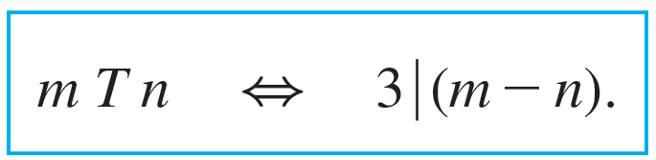
Example 8.2.4 – Properties of Congruence Modulo 3
Define a relation T on Z (the set of all integers) as follows: For all integers m and n,
This relation is called congruence modulo 3.
a. Is T reflexive? b. Is T symmetric? c. Is T transitive?

Slide 31


Example 8.2.4 – Solution
a. T is reflexive: To show that T is reflexive, it is necessary to show that For every m ∈ Z, m T m.
By definition of T, this means that
which is true because m − m = 0 and
(since 0 = 3 · 0). Hence T is reflexive.
b. T is symmetric: To show that T is symmetric, it is necessary to show that
For every m, n ∈ Z, if m T n then n T m.

Slide 32



Example 8.2.4 – Solution
continued
By definition of T this means that
Is this true? Suppose m and n are particular but arbitrarily chosen integers such that
Must it follow that
[In other words, can we find an integer so that n − m = 3 · (that integer)?] By definition of “divides,” since
then m − n = 3k for some integer k.

Slide 33
Example 8.2.4 – Solution
continued
The crucial observation is that n − m = −(m − n). Hence, you can multiply both sides of this equation by −1 to obtain
−(m − n) = −3k,
which is equivalent to
n − m = 3(−k).
[Thus we have found an integer, −k, so that n − m = 3 · (that integer).]

Slide 34

Example 8.2.4 – Solution
continued
Since −k is an integer, this equation shows that
It follows that T is symmetric.
c. T is transitive: To show that T is transitive, it is necessary to show that
For every m, n, p ∈ Z, if m T n and n T p then m T p.
By definition of T this means that

Slide 35



Example 8.2.4 – Solution
continued
Is this true? Suppose m, n, and p are particular but arbitrarily chosen integers such that
Must it follow that
[In other words, can we find an integer so that m − p = 3 · (that integer)?] By definition of “divides,” since
then
m − n = 3r for some integer r,
and
n − p = 3s for some integer s.

Slide 36

Example 8.2.4 – Solution
continued
The crucial observation is that (m − n) + (n − p) = m − p. Add these two equations together to obtain
(m − n) + (n − p) = 3r + 3s,
which is equivalent to
m − p = 3(r + s).
[Thus we have found an integer so that m − p = 3 · (that integer).] Since r and s are integers, r + s is an integer. So this equation shows that
It follows that T is transitive.

Slide 37
The Transitive Closure of a Relation

Slide 38
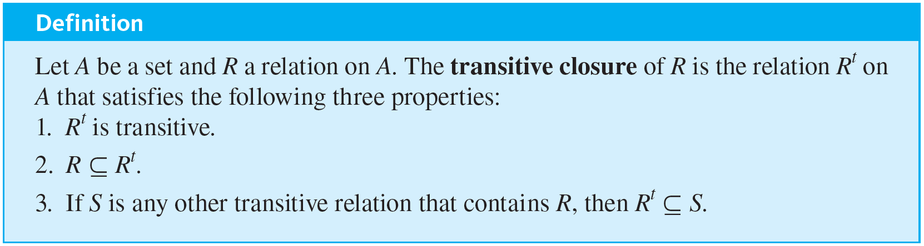
The Transitive Closure of a Relation
The relation obtained by adding the least number of ordered pairs to ensure transitivity is called the transitive closure of the relation. More precisely, the transitive closure of a relation is the smallest transitive relation that contains the relation.

Slide 39
Example 8.2.5 – Transitive Closure of a Relation
Let A = {0, 1, 2, 3} and consider the relation R defined on A as follows:
R = {(0, 1), (1, 2), (2, 3)}.
Find the transitive closure of R.

Slide 40


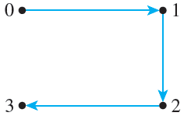
Example 8.2.5 – Solution
Every ordered pair in R is in
so
Thus the directed graph of R contains the arrows shown below.
Since there are arrows going from 0 to 1 and from 1 to 2,
must have an arrow going from 0 to 2.

Slide 41




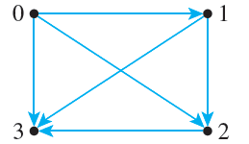
Example 8.2.5 – Solution
continued
Hence
so since
is transitive,
Also, since
contains at least the following ordered pairs:
{(0, 1), (0, 2), (0, 3), (1, 2), (1, 3), (2, 3)}.
But this relation is transitive; hence it equals
. The directed graph of
is shown below.

